Slide 2
Fragile Settings, Resilient People, & HIV
Shannon Hader, MD MPH
Deputy Executive Director Programme, UNAIDS

Slide 3
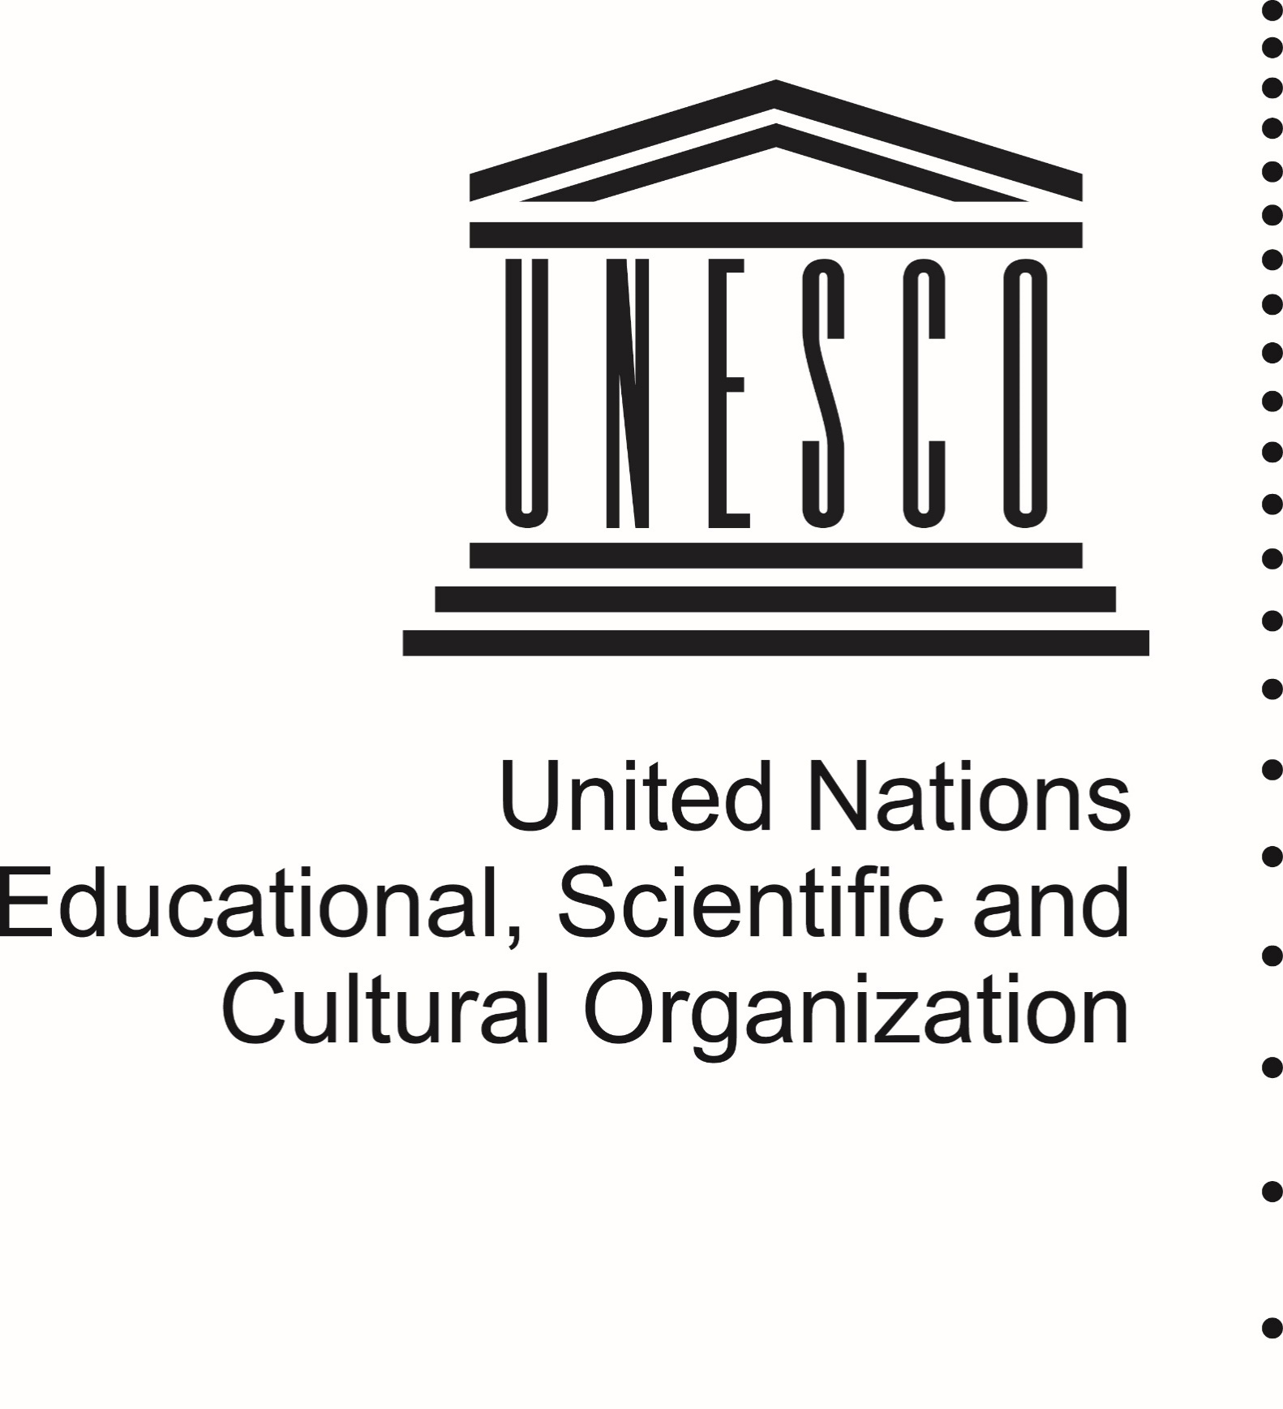

Slide 4
Fragile Settings & HIV
EMERGENCIES & Post-emergencies
Disaster
Conflict
Famine
Economic & Political Crises
HUMAN RIGHTS EMERGENCIES
INFORMAL SETTLEMENTS
INDIGENOUS COMMUNITIES
MIGRATION & Displacement
Internal
External

Slide 5
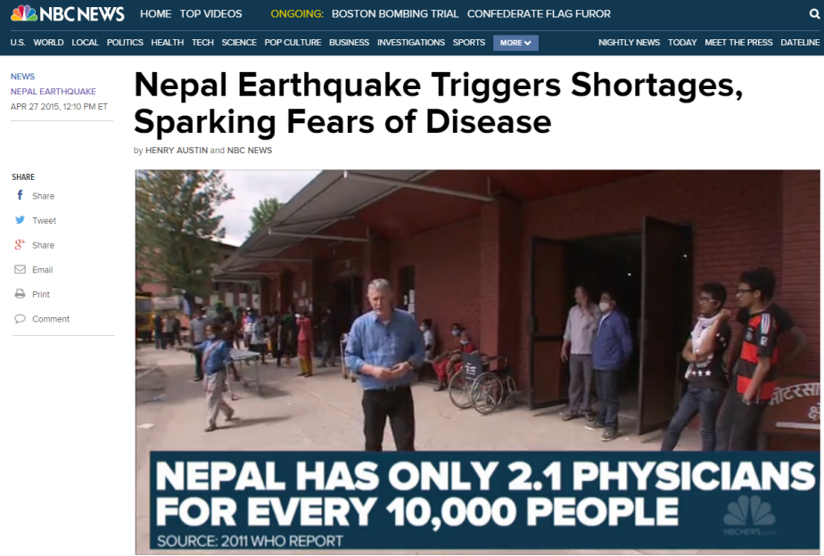
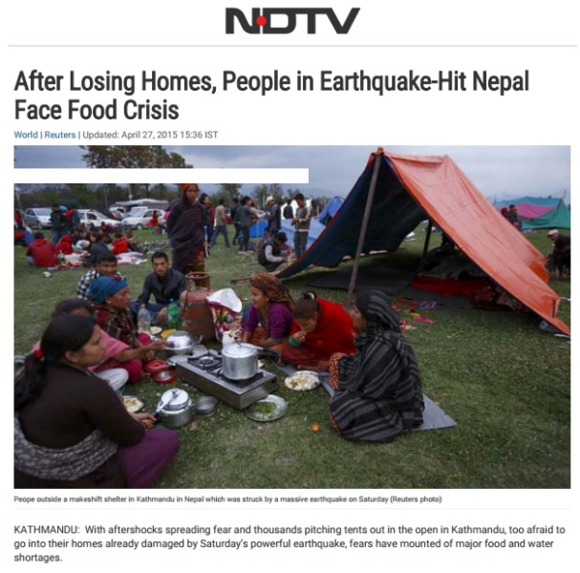
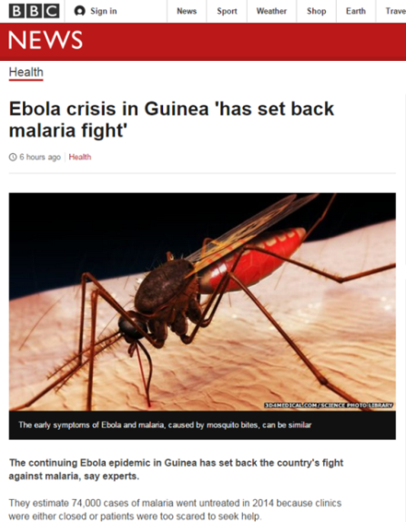
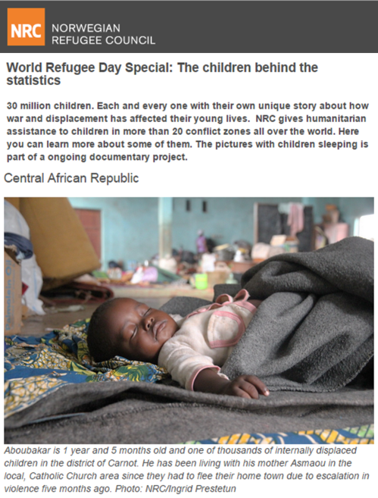
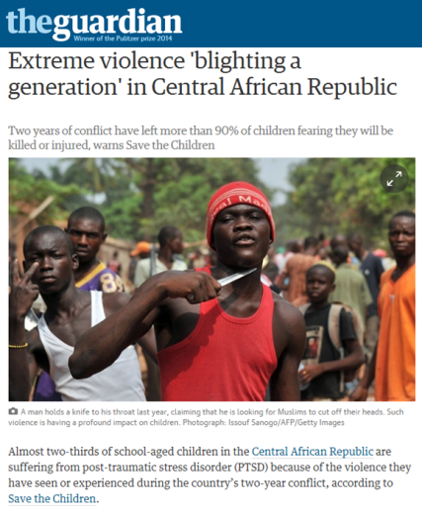
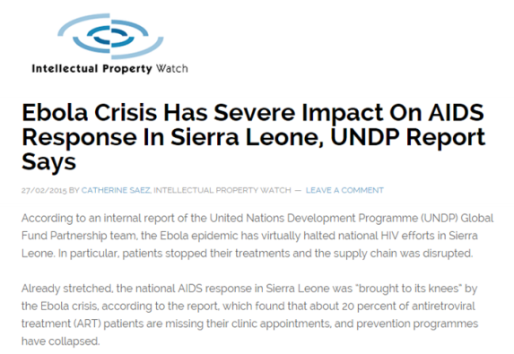
Emergencies are diverse… but are universally disruptive

Slide 6
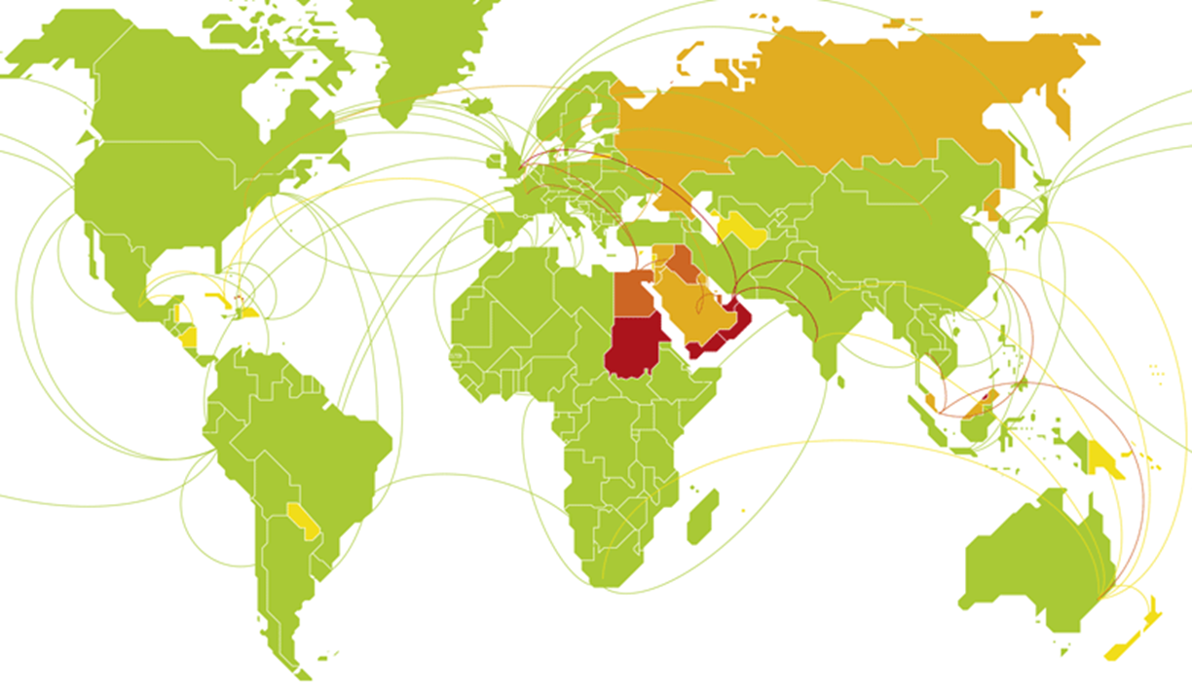
PLWHIV Increasingly Affected by Emergencies
1,600,000
PEOPLE LIVING WITH HIV AFFECTED BY HUMANITARIAN EMERGENCIES (2013)
>1 million people living with HIV did not access treatment in emergencies
Sources: UNHCR, UNICEF, UNAIDS 2015
Double Discrimination:
Restrictions magnified on people living with HIV…
HIV Vulnerability and Risk must be assessed & can be managed during emergencies
Sexual Violence
Common in emergency settings…
Notes:
ALSO: FOOD INSECURITY & HIV related risks
EXTRA RISKS FOR KEY POPULATIONS
Double discrimination: Restrictions on migrants, refugees and displaced people are magnified on people living with HIV
HIV vulnerability and risk can be managed during emergencies

Slide 7
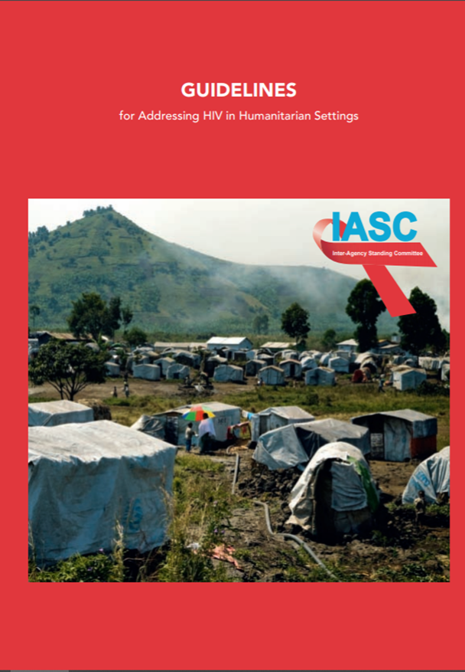
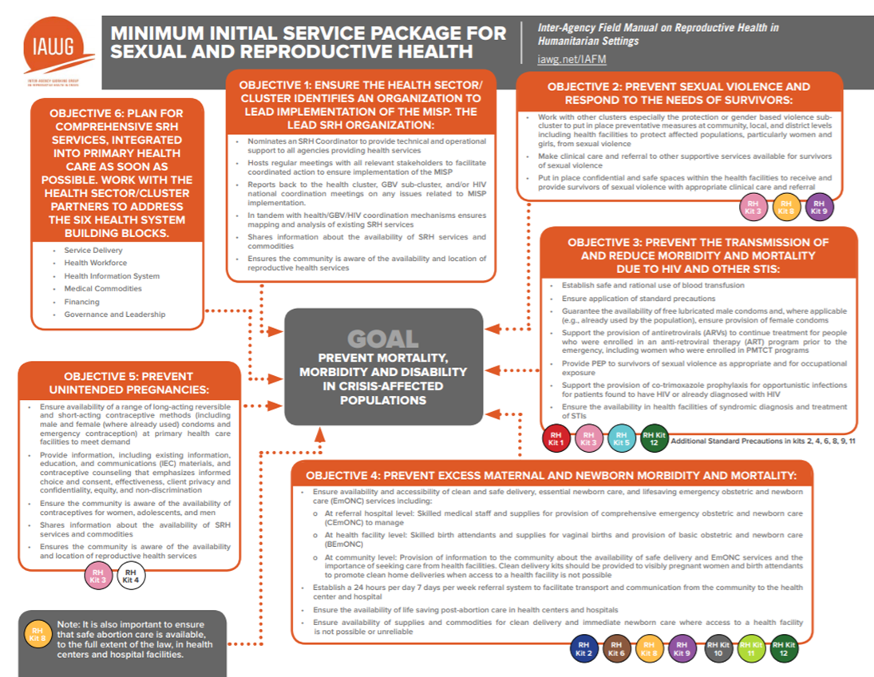
Integrated Assessments & Responses
Notes:
The IASC Guidelines for Addressing HIV in Emergencies & The Sphere Standards;
MISP (minimum initial service package) especially in the context of sexual and reproductive health care
Guidelines for the delivery of ARVs to migrants and crisis’affected persons in Africa

Slide 8
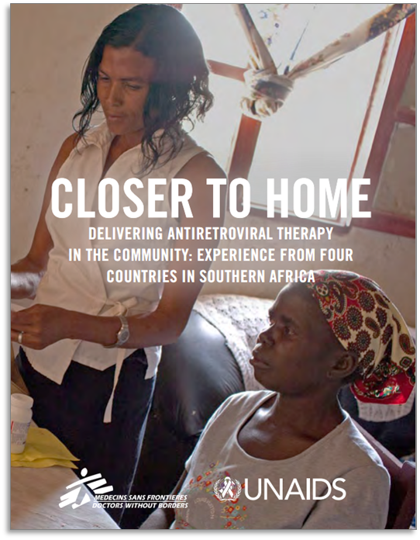
Preparedness: Stronger HIV program, More Resiliency in Emergencies
HIV PROGRAMS
RESILIENCY IN EMERGENCIES
Differentiated Service Delivery
Multi-month Dispensing
Unique IDs/portable health card
Community-based Services
Limited facility dependency
Community-led responses
Community Adherence Groups,
PLWHA Support Groups
Community Monitoring
Medications on-hand for rapid mobility or interrupted supplies
Access across service delivery sites
Bringing services to community, not moving the community to services
Shared problem-solving, communications, social supports
Ability to assess, report, account, especially in low-access areas
Notes:
Poor state of national HIV services in certain countries and isolated areas - how to extend non-existent or poor quality services to humanitarian affected populations (e.g. viral load services in West and Central Africa)
A re-shifting of focus, away from the centre… Humanitarian space often inaccessible to outsiders, including central government and the global humanitarian response The answer is decentralization of health care, community protection mechanisms and a sysems approach to ensure quality assured services. This can be remote programming which trusts and respects local loci for decision making Part of this compendium is the promotion of the policy of task-shifting and elevating community health workers, home-based care and point of site testing

Slide 9
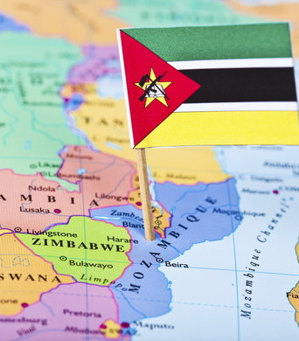
Mozambique A succession of tropical storms and cyclones (Idah and Kenneth) devastated large parts of the country,. Many of the affected areas where beyond reach to the international community. In response a governement endorsed initial Health Plan was prepared by the humanitarian partnership. This situation resulted in comprehensive support to civil society including networks of PLHIV to respond accordingly. Working with and through the Joint Team for HIV and AIDS, HIV mapping is being carried out with a focus on finding those on treatment but curently Lost To Follow Up. Patients LTFU is a growing concern for the country response and the disaster provided a futher the inpetus to increasingly and more urgently address these concerns. It is very much a community response meeting a community need. The humanitarian community has assisted and provided critical supplies, including the means for mobile health, establishing humanitarian hubs but the focus on local decision making and engagement of civil society and, in particular. women’s groups.

Slide 10
2019 Cyclones, Mozambique
Cyclone 1 (Idai): Sofala
Cyclone 2 (Kenneth): Cabo Delgado
Sofala has ~197,000 PLHIV.
Prior to the cyclone, Beira Corridor highest LTFU: 28-36% unretained
After: 50% drop in HIV consultations
Cabo Delgado has ~160 000 PLHIV.
Prior to the cyclone, LOW ART coverage 33% (51 500) adults, children 39% (4 800)

Slide 11
Checklist – UNAIDS Country office Engagement in Humanitarian Response:
Weekly HIV and Emergencies UN Joint Team meetings, refresher training.
Mission to meet key stakeholder, observe and assess the impact of the crisis and associated needs, response efforts, & gaps
UNCT high-level meetings, Joint missions
Coordination:
Weekly HCT meetings – chaired by RC
Bi-weekly national & provincial HCT cluster mtgs – 4Ws, newsletter
PSEA working group
Resource mobilization: CERF proposal ART retention; Health Response plan; One UN Fund joint proposal
Post Disaster Needs Assessment - training; report
Donor pledging conference
Briefings to RST and HQ
Interagency HIV Rapid Assessment
Enhancing key stakeholders capacity to integrate HIV in emergency preparedness and response plans

Slide 12
JOINT MISSION: Global Fund, PEPFAR, UNAIDS JOINT PROGRAM
HQ
Regional Support Team
Partnership: Reduce verticalization (siloing) in relation to follow-up of agreed actions of the mission– How? Joint agency calls, reviews of Sit Room
Political: High Level joint visit to galvanize political commitment at the highest level
Political: Engagement with monthly (POART calls) data review of retention site level trends
Strategic Information: Production of HIV data for humanitarian response
Community: Treatment Literacy
Management: Reinforce UN Country Office humanitarian and commodity forecasting capacity
Political: Advocacy with Minister of Health at SADC Sustainability meeting in Namibia
Community: Establishment of social contracting mechanism for civil society to enhance HIV service delivery and retention.
Community: Stigma Index implementation
Induction of the new SI Advisor

Slide 13
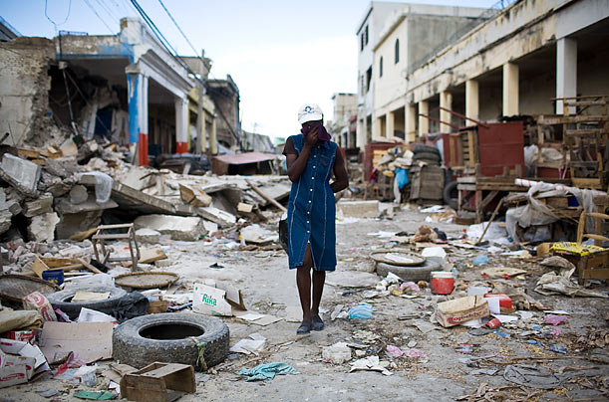
Recovery: Build it Better than Before
PMTCT COVERAGE:
2009: 44%
2010: 32%
2014: 87%
-------EARTHQUAKE------
Notes:
Human Immunodeficiency Virus Treatment
Although severely affected by the earthquake, human immunodeficiency virus (HIV) clinical services supported by the President's Emergency Plan for AIDS Relief were restored quickly. For example, from October 1, 2008, to September 30, 2009, 44% (1,881 of 4,275) identified HIV-positive pregnant women received antiretroviral medicines to prevent HIV transmission to their children. This coverage fell to nearly 32% (1,115 of 3,563) the following year, which included the earthquake, but rebounded to 87% (4,783 of 5,502) (Figure) from October 2013 to September 2014. Similar recoveries occurred for other services, including antiretroviral therapy enrolment and screening of tuberculosis patients for HIV infection (4).

Slide 14
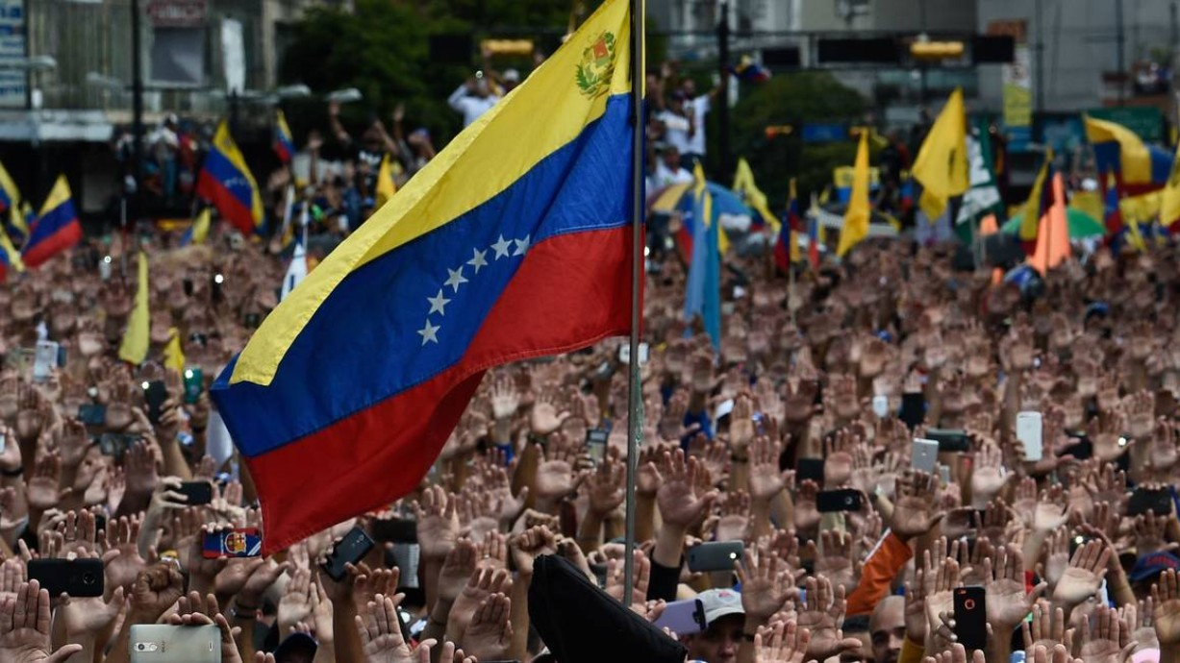
Venezuela Ongoing situation has brought together an unprecented collaberation between partners. Under stewardship of IOM and UNHCR, there are active fora for cooridnation of activities within country and in neighbouring countries. With support from the Global Fund Emergency Grant, stocks of DLG have been brought to the country to meet immediate needs. Plans are underway to request further provisions UNAIDS and the Joint Team working with civil society and networks of PLHIV to devise a plan for distribution for this medication to parts of the country where it is needed the most. Discussions with Ministry of Health ongoing on utilization of existing stocks of ART and to ensure a clear system of usage and reporting. This disaster quickened the supply of the right treatment to a population in urgent need The Venezuela crisis has necessitated a regional approach, notably including, Colombia, Ecuador, Peru, Brazil, Mexico and countries in Central America and the Caribbean. Of note, all countries in South America provide ARVs to migrants without any cost to them. A Humanitarian Regional Refugee and Migrant Response Plan (RMRP) has been prepared and being updated to meet needs and demands

Slide 15
Regional Collaboration & Response
QUITO DECLARATION ON
HUMAN MOBILITY OF VENEZUELAN CITIZENS IN THE REGION
11 Latin American Countries
Basis for consideration to: 1) Guarantee HIV treatment for all migrants 2) Accelerate transition to TLD 3) Make TLD available to all migrants
UNRESOLVED:
ABILITY TO ACCESS GENERIC/LOW-PRICED HIV COMMODITIES
DURING EMERGENCIES

Slide 16
Civil Society Monitoring

Slide 17
Human Rights Emergencies
and other men who have sex
with men into hiding
Criminalization of same-sex sexual acts, global, 2017
Death penalty
Imprisonment or no penalty specified
Data not available
Laws penalizing same-sex sexual acts have been decriminalized or never existed, or no specific legislation
Source: 2017 National Commitments and Policy Instrument.
Notes:
When we talk about emergencies we often overlook human rights emergencies, in which not only human rights are violated, but also have an impact on health.
An environment of criminalization and discrimination fuels these emergencies. Laws and policies aimed at discouraging behaviours deemed culturally or religiously inappropriate can legitimize stigma and give license to discrimination and harassment, and violence, isolating people who are at high risk of HIV infection and hindering them from accessing vital HIV and health services.
As an example based on our NCPI:
Among 100 countries that reported data to UNAIDS in 2017, 44 stated they had laws specifically criminalizing same-sex sexual intercourse.
About three quarters of reporting countries criminalize some aspect of sex work, and 87% criminalize drug use or possession of drugs.
Nearly half of reporting countries said they had laws that criminalize HIV transmission, nondisclosure or exposure.
These situations can create a climate that condones violence and generate human rights emergencies, which include:
--Arrests and prosecution, attacks and violence on key populations,
--raiding of NGO premises,
--new Bill that criminalizes key populations in Parliament,

Slide 18
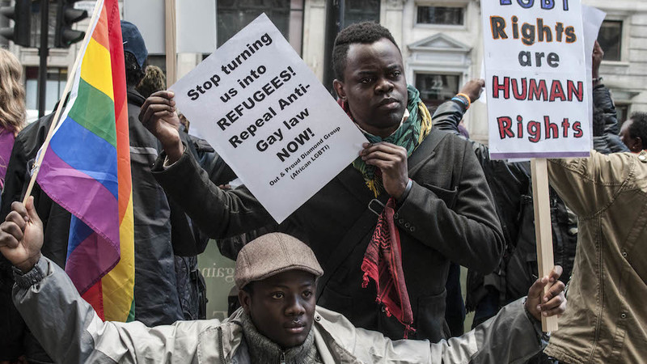
In focus: Mass Arbitrary Arrests of MSM
NEEDS:
Immediate safety protection
Support of communities
Coordination of rapid response
Legal Assistance
Notes:
Discrimination and violence against lesbian, gay, bisexual, transgender and intersex (LGBTI) people in Nigeria are far too common. Human rights violations against LGBTI people are fueled by coercive and discriminatory legislation: Same-sex sexual relations are criminalized in the country, and in some northern Nigerian states where Shari’a law is applied, these acts are punishable by death. The Same-Sex Marriage (Prohibition) Act of 2013 imposes prison terms of 14 years for anyone who enters a same-sex marriage or civil union. Following passage of this Act, harassment and violence against LGBTI people increased in many parts of the country.
UNAIDS country team focused on reacting to crises of mass arbitrary arrests of young men suspected of homosexuality, by mobilizing a small crisis team that coordinated actions to ensure accused individuals would be released from prison.
In February 2014, 15 young men were brutalized by an angry mob, forced from their homes and cast out of their community in Gishiri, a village within the Nigerian capital. In the preceding weeks, 12 young men were physically assaulted and held in unlawful police detention in Bauchi, a northern Nigerian state. The alleged crime of these men, along with countless others in the country, was engaging in same-sex sexual relations. Discrimination and violence against lesbian, gay, bisexual, transgender and intersex (LGBTI) people in Nigeria are far too common.
Human rights violations against LGBTI people are fueled by coercive and discriminatory legislation: Same-sex sexual relations are criminalized in the country, and in some northern Nigerian states where Shari’a law is applied, these acts are punishable by death. The Same-Sex Marriage (Prohibition) Act of 2013 imposes prison terms of 14 years for anyone who enters a same-sex marriage or civil union. The law also punishes establishing, supporting, and participating in gay organizations and public displays of affection with 10 years in prison. Following passage of this Act, harassment and violence against LGBTI people increased in many parts of the country.1
In response to the crisis UNAIDS supported the creation of a group of volunteer practicing lawyers. The lawyers reacted to the crises helping free those men that were prosecuted. The trained lawyers then formed the Coalition of Lawyers for Human Rights (CoLaHR) to provide legal services in cases of future violation of the rights of key populations.

Slide 19
From Emergency Support to Resilient Resource
Crisis group formed in response to mass arrests of MSM
UNAIDS supported creation of group of volunteer practicing lawyers
They then formed the Coalition of Lawyers for Human Rights (CoLaHR), to respond in case of future violations
Notes:
UNAIDS country team focused on reacting to crises of mass arbitrary arrests of young men suspected of homosexuality, by mobilizing a small crisis team that coordinated actions to ensure accused individuals would be released from prison.
In response to the crisis UNAIDS supported the creation of a group of volunteer practicing lawyers. The lawyers reacted to the crises helping free those men that were prosecuted. The trained lawyers then formed the Coalition of Lawyers for Human Rights (CoLaHR) to provide legal services in cases of future violation of the rights of key populations.
This Network created to respond to immediate crisis still exists and continues to serve communities.
A crisis was used to support communities to organize themselves and strengthen a service that could be available in case of future situations where communities require legal support

Slide 20
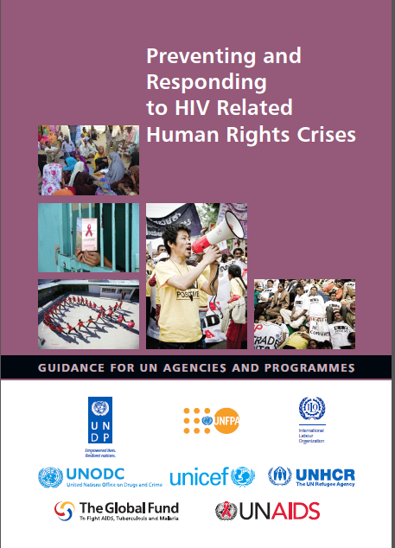
Critical Elements to Address Human Rights Emergencies
Political will
Funding for communities for rapid response and beyond
Implementation of tools for stakeholders
Long term investments in human rights programs
(e.g. for law enforcement, prisons personnel, legal literacy programs)
Notes:
-Political will –in short term, to support those most impacted (for example from UN). In the longer terms to support changes in the legal and policy environment, and reduce stigma.
-Funding to support communities as they react to the immediate needs and also beyond: “resilience builders” (legal aid for example, know your rights campaigns, creation and support for networks of key pops)
--Tools so institutions are prepared: for example at UN level the Guidance on Preventing and addressing human rights crisis
--Long term investments: key human rights programmes are necessary and often overlooked investments -- central to creating an enabling environment (e.g. anti-stigma training of law enforcement and prisons personnel, health care workers, legal literacy programs)
As UNAIDS we produce with other partners a guidance so UN entities would be prepared to respond to human rights emergencies. This guides our country teams and us in GVA and regional offices to support such responses.

Slide 21
2018 UNAIDS JOINT PROGRAMME Highlights: UNHCR, UNFPA, WFP, WHO, WB, UNICEF, Secretariat, others
Made HIV-sensitive humanitarian protection and assistance available to 59 million refugees, returnees, internally displaced and stateless people
Doubled resources for fragility, conflict and violence-affected countries to USD 14 billion
Increased number of PLWHA refugees on ART 4-fold from 2014 to 2018
In camp-based settings: Provided HIV Counseling &Testing to 319,906 persons, including 123,359 pregnant women; Distributed 7,538,901 male and 122,271 female condoms
Provided food and nutrition support to PLHIV and TB clients directly in 14 humanitarian contexts, and indirectly in 31 humanitarian contexts
Distributed 12,000 Inter-Agency Emergency Reproductive Health Kits to 55 countries to serve estimated 3.2 to 5.5 million people

Slide 22
UNAIDS Daily Duties HUMAN RIGHTS EMERGENCIES
Ensure that those arrested have legal representation – finding and hiring lawyers.
Attend court cases – people notice when UNAIDS is the courtroom
Pay for safe housing when lives are at risk
Coordinate key donors and diplomats for united approach
Convene CSOs so that police don’t raid their meetings
Convene dialogues between CSOs and the police
Do high level advocacy with government officials and judges
Prevent--stop bad laws from being adopted or implemented
And more – sometimes as simple as talking to the parents of a young man arrested

Slide 23
Resilient People Communities at the Center
In times of fragility, crisis-affected people display incredible resilience… …resilience to disaster and resilience in the face of HIV and AIDS …it is this resilience that UNAIDS supports - women’s groups in South Sudan on protection and reporting on SGBV - pastoralists in Somalia, on mobile health care - networks of PLHIV in Malawi, addressing stigma and disaster response

Slide 24
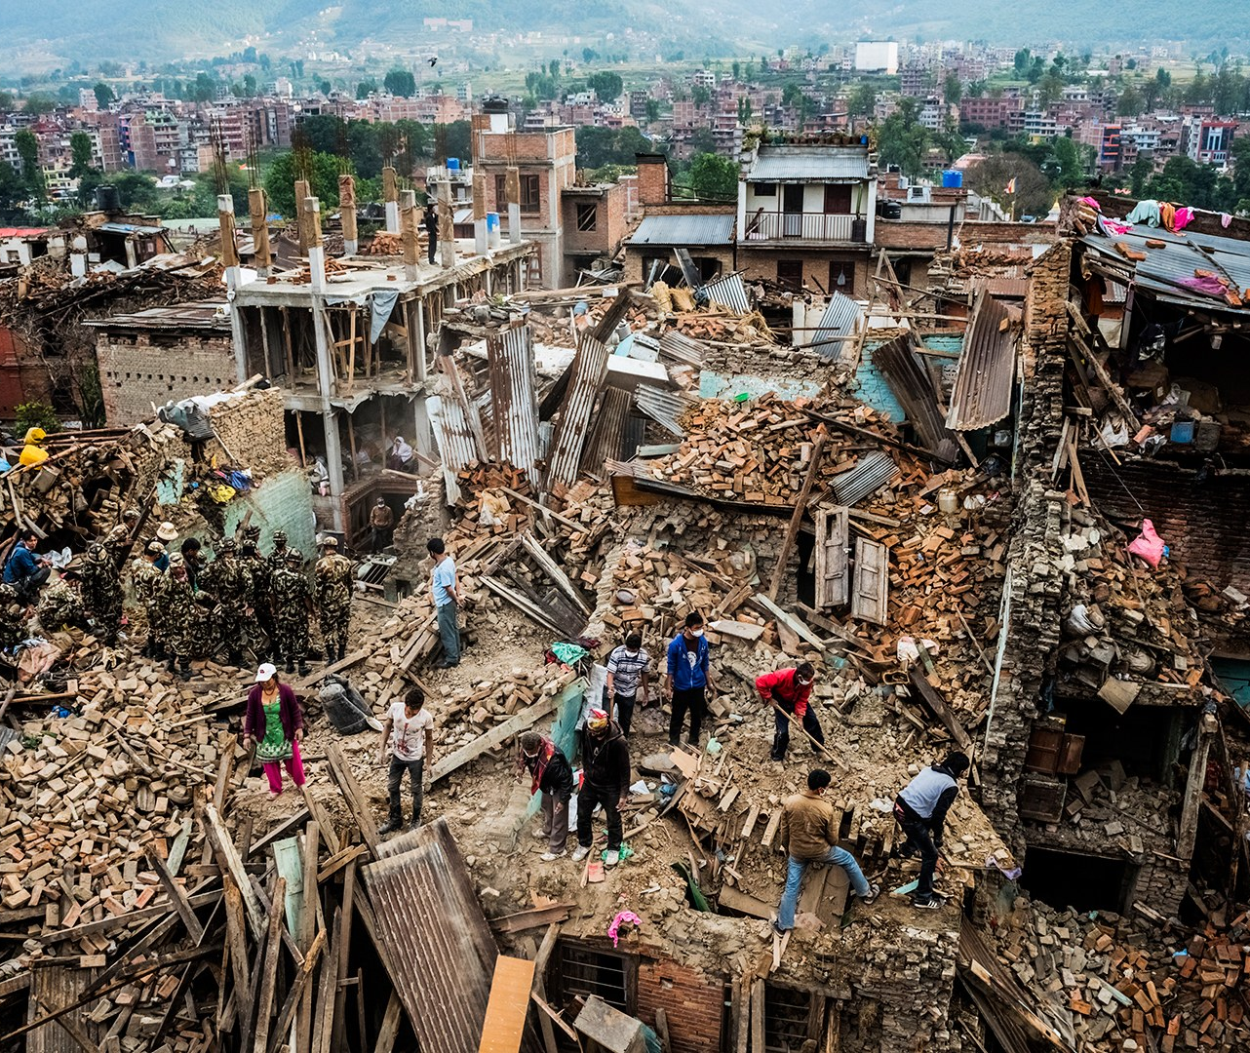
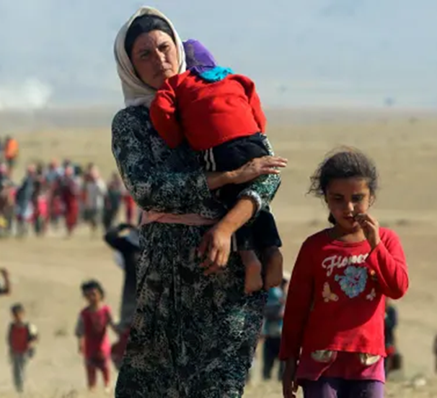
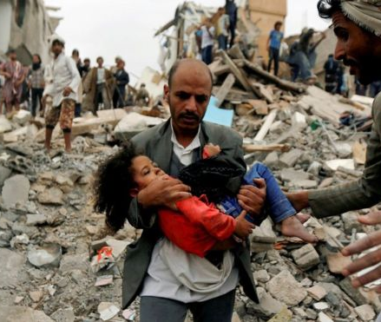
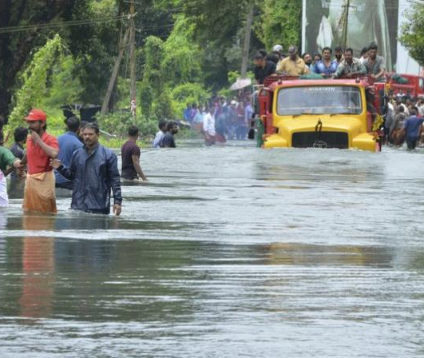
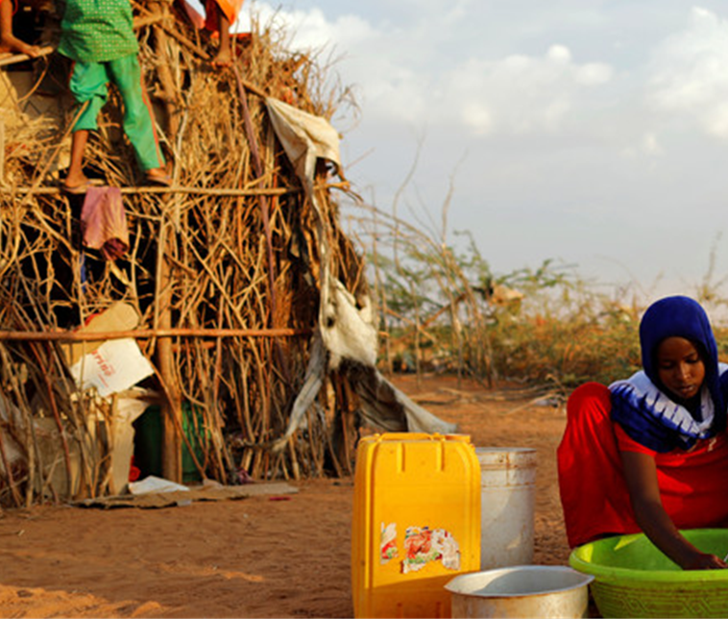
THANK YOU
MAY WE RECOGNIZE AND SUPPORT
RESILIENT PEOPLE
Notes:
As we speak about frameworks and numbers we should not forget the people – fragility is people in the slums, people in extreme poverty, key populations affected by punitive laws; people in conflic areas; people affected by climate change and other natural disasters; migrants and displaced persons
In most cases their lives and health is affected by disruption in governance and infrastructure– in other cases they are responsibility of no one, and in some cases they are penalised because of who they are – what is common to all these circumstances is the end result – the disruption in access to basic neccessities including health

